Slide 1
Big Mountain Resort: A Ticket Price Analysis
Daniel Pickett

Slide 2
Problem Identification: Background
Big Mountain Resort: large ski resort in Montana offering wide variety of features
Seasonal attendance average: ~350,000 skiers, 5 days each
Recently installed a new lift increasing operating costs by $1.54m per season
Currently charging $81.00 per weekend ticket for adults
Based on market average, not on Big Mountain’s offered features

Slide 3
Problem Identification: Scenarios
Question #1: How much is an adult weekend ticket actually worth?
Question #2: Would any of the following changes significantly cut costs or support an increase in ticket price?
Change #1: Permanently close up to 10 of the least used runs
Change #2: Increase vertical drop by 150 ft and install additional lift to support this, without adding any snow-making coverage
Change #3: Increase vertical drop by 150 ft and install additional lift to support this, with 2 acres of additional snow-making coverage
Change #4: Increase longest run by 0.2 mi to total of 3.5 mi, with 4 acres of additional snow-making coverage

Slide 4
Key Findings and Recommendation
Answer #1: Based on Big Mountain’s offered features, an adult weekend ticket is worth $108.30
Answer #2: Apply change #2, and close up to one run per change #1
Change #1: One run closed would not call for a price decrease; more than one would
Change #2: This increase would allow for a price increase of $3.00
Change #3: The additional snow-making coverage would not make a difference in price increase compared to change #2, while adding operating cost
Change #4: This increase would not allow for a price increase, while adding operating cost

Slide 5
Modeling Results and Analysis
Created state-level data and compared it vs. ticket price – no clear correlation
Created “state resort competition” to further see if higher percent of assets in a given state correlated to ticket price – they aren’t, although they are highly correlated with number of resorts
Visualized this with heat map and scatterplots
These suggested these fields as highly correlated to ticket price: vertical_drop, fastQuads, Runs, total_chairs, Snow Making_ac

Slide 6
Modeling Results and Analysis
Created model of best fit from data of all other US resorts in Big Mountain’s market range that best estimates ticket price, “AdultWeekend”
This determines the fields most likely to explain current ticket price and therefore predict future ticket price
Also included several custom fields:
State-wide summaries, to see if states themselves correlated to higher price
“State resort competition” ratios, to see if a higher percentage of a resort’s features in a given state correlated to higher price
Additionally built a heat map to better visualize the correlation between each variable, with emphasis on correlation with “AdultWeekend”

Slide 7
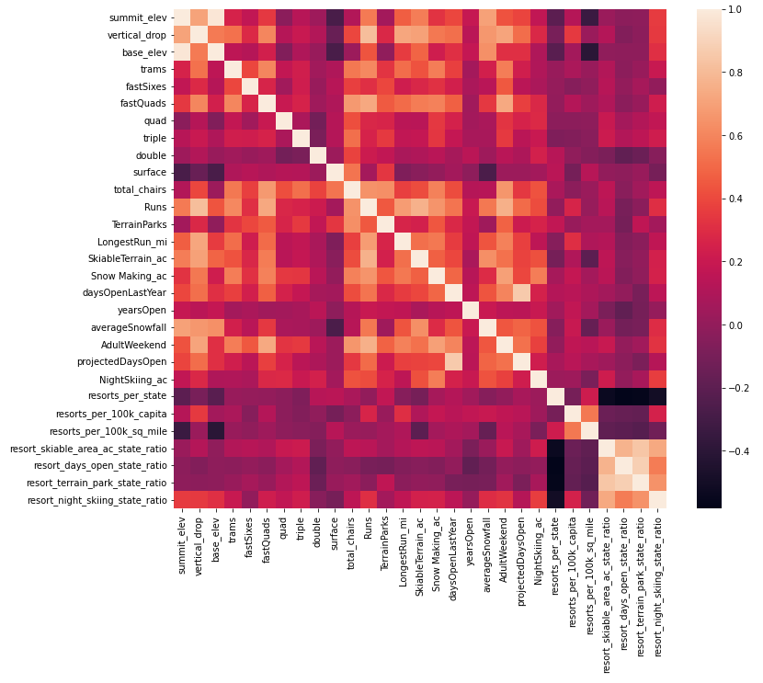
Modeling Results and Analysis (cont.)
Determined 5 fields highly correlated with “AdultWeekend”:
“vertical_drop”
“fastQuads”
“total_chairs”
“Runs”
“Snow Making_ac”
Conceptually, these make sense – the more land/options for skiing, the more a visitor is willing to pay
No state-wide summary is highly correlated – state is likely not a factor in ticket price
No competition ratio is highly correlated – having more features compared to other resorts in the same state is likely not a factor in ticket price
The ratios are highly negatively correlated with number of resorts in a state – the more resorts in a state, the smaller ratio of features a given resort will likely have

Slide 8
Modeling Results and Analysis (cont.)
Based on the levels of features within Big Mountain, the model calculates an expected ticket price of $108.30, with an approximate error of $10.24
Even accounting for error, this expected price is significantly larger than the current price of $81.00
Increasing the price from $81.00 to $108.30 would increase seasonal revenue by [350,000 * 5 * ($108.30 - $81.00) = $47.78m], easily offsetting the operating cost of the new lift

Slide 9
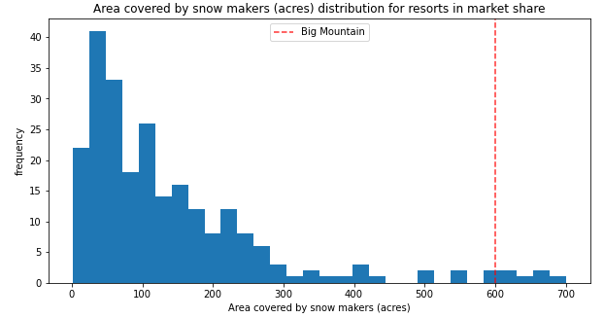
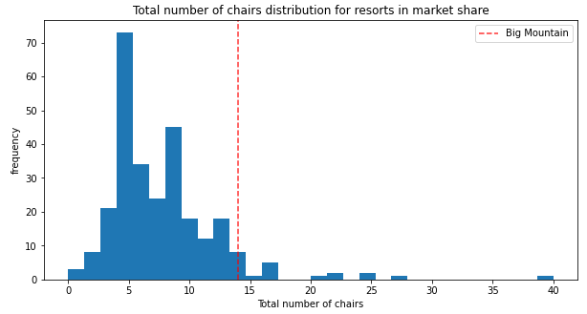
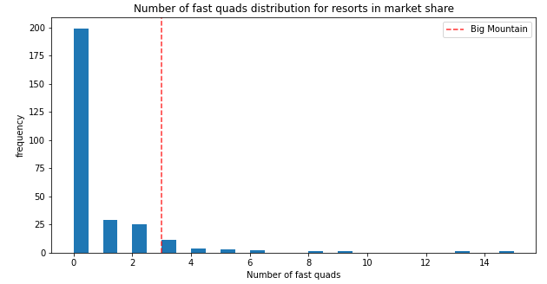
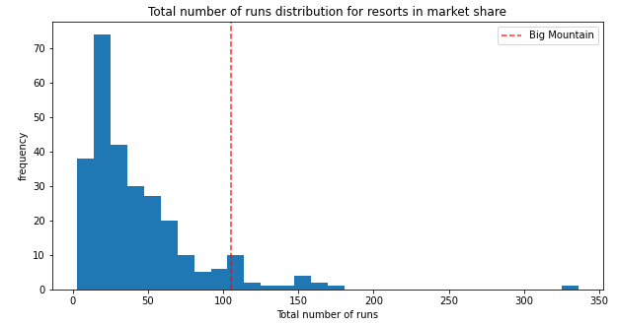
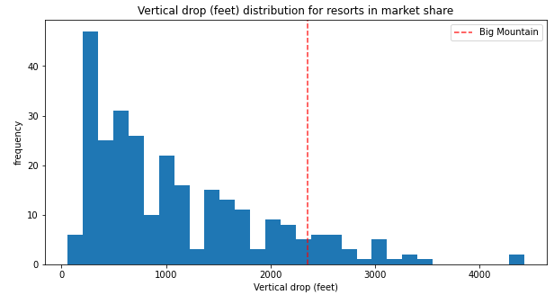
Modeling Results and Analysis (cont.)
Big Mountain’s levels of top 5 features compared to other resorts:
“fastQuads”, “total_chairs”, “Runs”, and “Snow Making_ac” are among the highest in the country
“vertical_drop” ranks not as high but is still competitive

Slide 10
Conclusion
Big Mountain is charging a ticket price based on the average resort, despite having above-average features
Big Mountain can afford to raise the ticket price from $81.00 to $108.30 for an average revenue increase of $47.78m, offsetting the $1.54m increase in operating cost of the new lift
Additionally, Big Mountain may increase its vertical drop (without creating additional snow-making coverage) and close its least used run in order to support a further increased ticket price and decrease operating costs without significantly affecting attendance

